Slide 1
Lecture 12
Summary system of linear equations

Slide 2
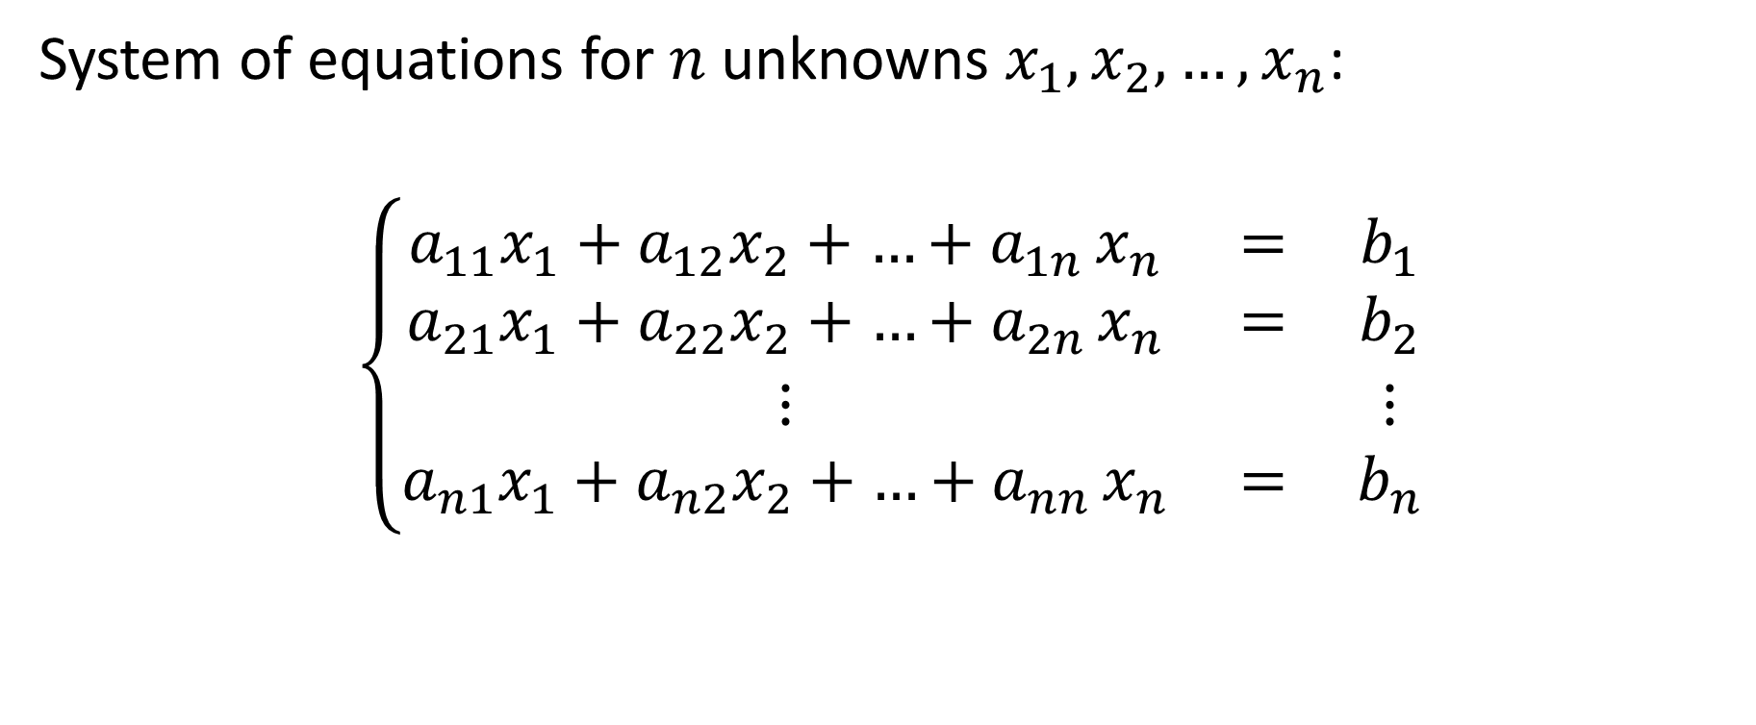
General system of linear equations
System of equations for $n$ unknowns $x_{1},x_{2},…,x_{n}$:
$$\left\{\begin{matrix}a_{11}x_{1}+a_{12}x_{2}+{…+a}_{1n}x_{n} & = & b_{1} \\ a_{21}x_{1}+a_{22}x_{2}+{…+a}_{2n}x_{n} & = & b_{2} \\ ⋮ & & ⋮ \\ a_{n1}x_{1}+a_{n2}x_{2}+{…+a}_{nn}x_{n} & = & b_{n}\end{matrix}\right.$$
Notes:
A general system of linear equations with n unknowns x1 to xn writes as displayed on the slide.

Slide 3



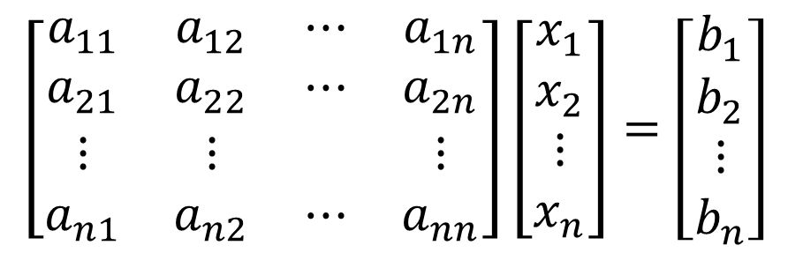
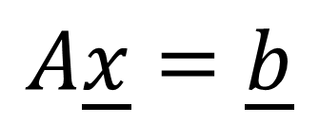
Equivalent matrix equation
Right-hand-side vector $\underline{b}$
$$\left[\begin{matrix}a_{11} & a_{12} & ⋯ & a_{1n} \\ a_{21} & a_{22} & ⋯ & a_{2n} \\ ⋮ & ⋮ & & ⋮ \\ a_{n1} & a_{n2} & ⋯ & a_{nn}\end{matrix}\right]\left[\begin{matrix}x_{1} \\ x_{2} \\ ⋮ \\ x_{n}\end{matrix}\right]=\left[\begin{matrix}b_{1} \\ b_{2} \\ ⋮ \\ b_{n}\end{matrix}\right]$$
Coefficient matrix $A$
Column vector $\underline{x}$
of unknowns
$$A\underline{x}=\underline{b}$$
Notes:
A more compact and efficient notation is the matrix notation
For this we introduced the coefficient matrix A, the vector of unknowns x and the right-hand side vector b.
Using these definitions the matrix equation Ax=b is then equivalent to the linear system of equations with the unknowns x1 to xn.

Slide 4






Solution Space
$$x_{2}$$
$$x_{2}$$
$$x_{2}$$
One solution
Infinite number
of solutions
No solution
$$x_{1}$$
$$x_{1}$$
$$x_{1}$$
Notes:
A linear system of equations will have either
Exactly one solution when the two lines representing the equations have one intersection point.
An infinite number of solutions if both equations are represented by a same line
Or no solution at all if the two lines are parallel to each others

Slide 5
Solving linear systems of equations
We discussed the following algorithms:
Naïve Gauss elimination
Gauss elimination with partial pivoting
LU decomposition
AP=LU decomposition
Notes:
We discussed the following algorithms:
Naïve Gauss elimination
Gauss elimination with partial pivoting
LU decomposition
AP=LU decomposition

Slide 6
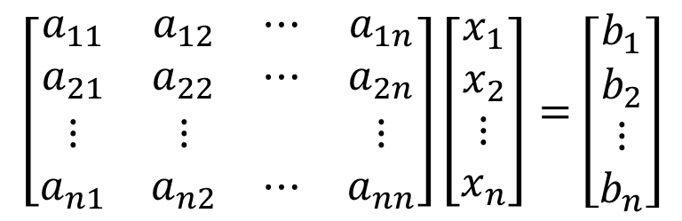
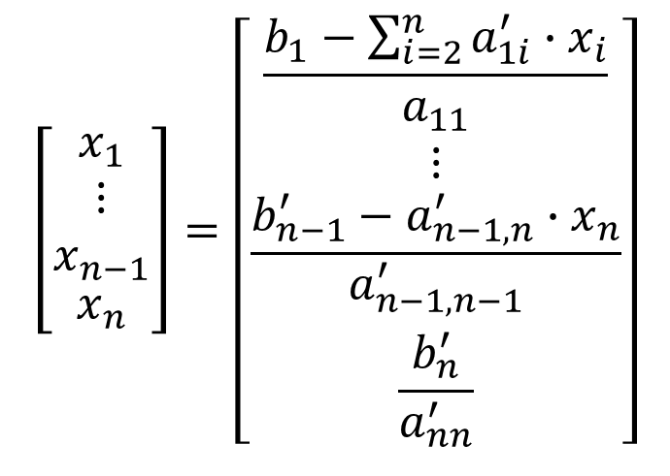
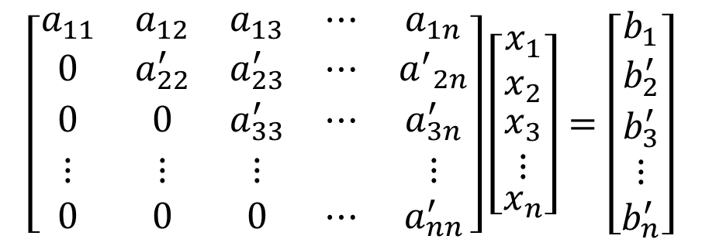
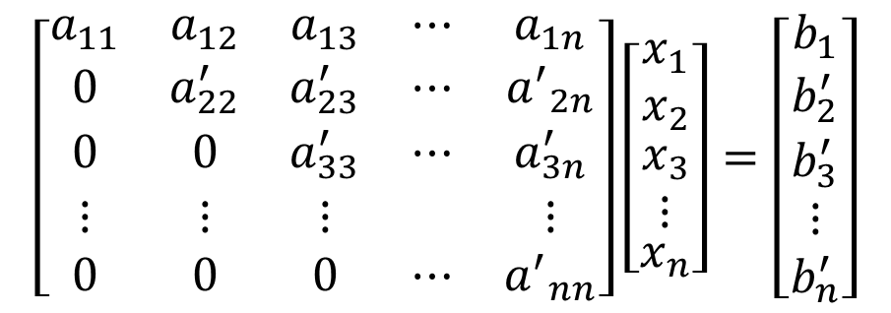
Gauss elimination
$$\left[\begin{matrix}a_{11} & a_{12} & a_{13} & ⋯ & a_{1n} \\ 0 & a_{22}^{′} & a_{23}^{′} & ⋯ & {a^{′}}_{2n} \\ 0 & 0 & a_{33}^{′} & ⋯ & a_{3n}^{′} \\ ⋮ & ⋮ & ⋮ & & ⋮ \\ 0 & 0 & 0 & ⋯ & {a^{′}}_{nn}\end{matrix}\right]\left[\begin{matrix}x_{1} \\ x_{2} \\ \begin{aligned}x_{3} \\ ⋮\end{aligned} \\ x_{n}\end{matrix}\right]=\left[\begin{matrix}b_{1} \\ \begin{aligned}b_{2}^{′} \\ b_{3}^{′}\end{aligned} \\ ⋮ \\ b_{n}^{′}\end{matrix}\right]$$
$$\left[\begin{matrix}a_{11} & a_{12} & ⋯ & a_{1n} \\ a_{21} & a_{22} & ⋯ & a_{2n} \\ ⋮ & ⋮ & & ⋮ \\ a_{n1} & a_{n2} & ⋯ & a_{nn}\end{matrix}\right]\left[\begin{matrix}x_{1} \\ x_{2} \\ ⋮ \\ x_{n}\end{matrix}\right]=\left[\begin{matrix}b_{1} \\ b_{2} \\ ⋮ \\ b_{n}\end{matrix}\right]$$
Forward
elimination
$$\left[\begin{matrix}x_{1} \\ \begin{aligned}⋮ \\ x_{n−1}\end{aligned} \\ x_{n}\end{matrix}\right]=\left[\begin{matrix}\frac{b_{1}−\sum_{i=2}^{n}{a_{1i}^{′}∙x_{i}}}{a_{11}} \\ ⋮ \\ \frac{b_{n−1}^{′}−a_{n−1,n}^{′}{∙x}_{n}}{a_{n−1,n−1}^{′}} \\ \frac{b_{n}^{′}}{a_{nn}^{′}}\end{matrix}\right]$$
$$\left[\begin{matrix}a_{11} & a_{12} & a_{13} & ⋯ & a_{1n} \\ 0 & a_{22}^{′} & a_{23}^{′} & ⋯ & {a^{′}}_{2n} \\ 0 & 0 & a_{33}^{′} & ⋯ & a_{3n}^{′} \\ ⋮ & ⋮ & ⋮ & & ⋮ \\ 0 & 0 & 0 & ⋯ & a_{nn}^{′}\end{matrix}\right]\left[\begin{matrix}x_{1} \\ x_{2} \\ \begin{aligned}x_{3} \\ ⋮\end{aligned} \\ x_{n}\end{matrix}\right]=\left[\begin{matrix}b_{1} \\ \begin{aligned}b_{2}^{′} \\ b_{3}^{′}\end{aligned} \\ ⋮ \\ b_{n}^{′}\end{matrix}\right]$$
Back
substitution
Notes:
Gauss elimination transforms the system into an upper diagonal system form by forward elimination.
The upper diagonal system is solved by back substitution

Slide 7

Gauss elimination with partial pivoting
Pivoting strategy takes care to exchange the equations such to avoid problems with division by zero or division by small numbers
It scans the column below (including) the pivot element and exchanges it with the largest entry in absolute value found
$$\left[\begin{matrix}a_{11} & a_{12} & ⋯ & a_{1n} \\ 0 & a_{22}^{′} & ⋯ & a_{2n}^{′} \\ a_{31} & a_{32} & ⋯ & a_{3n} \\ ⋮ & ⋮ & & ⋮ \\ a_{n1} & a_{n2} & ⋯ & a_{nn}\end{matrix}\right]\left[\begin{matrix}x_{1} \\ x_{2} \\ x_{3} \\ ⋮ \\ x_{n}\end{matrix}\right]=\left[\begin{matrix}b_{1} \\ b_{2}^{′} \\ b_{3} \\ ⋮ \\ b_{n}\end{matrix}\right]$$
Pivot element
Scanned elements
Notes:
Gauss elimination with partial pivoting adds a further step, the so-called pivoting step.
The pivoting step aims to exchange equations which may lead to problems, either due to division by zero or division by small numbers, by other equations.
To determine the needed switching of equations, one scans all elements of the column starting from the pivot element downwards, and searches for the largest one in absolute value among them
If the pivot element is already the largest one nothing needs to be done
Otherwise, one exchanges the equation containing the pivot element with the equation containing the largest entry in absolute value.

Slide 8
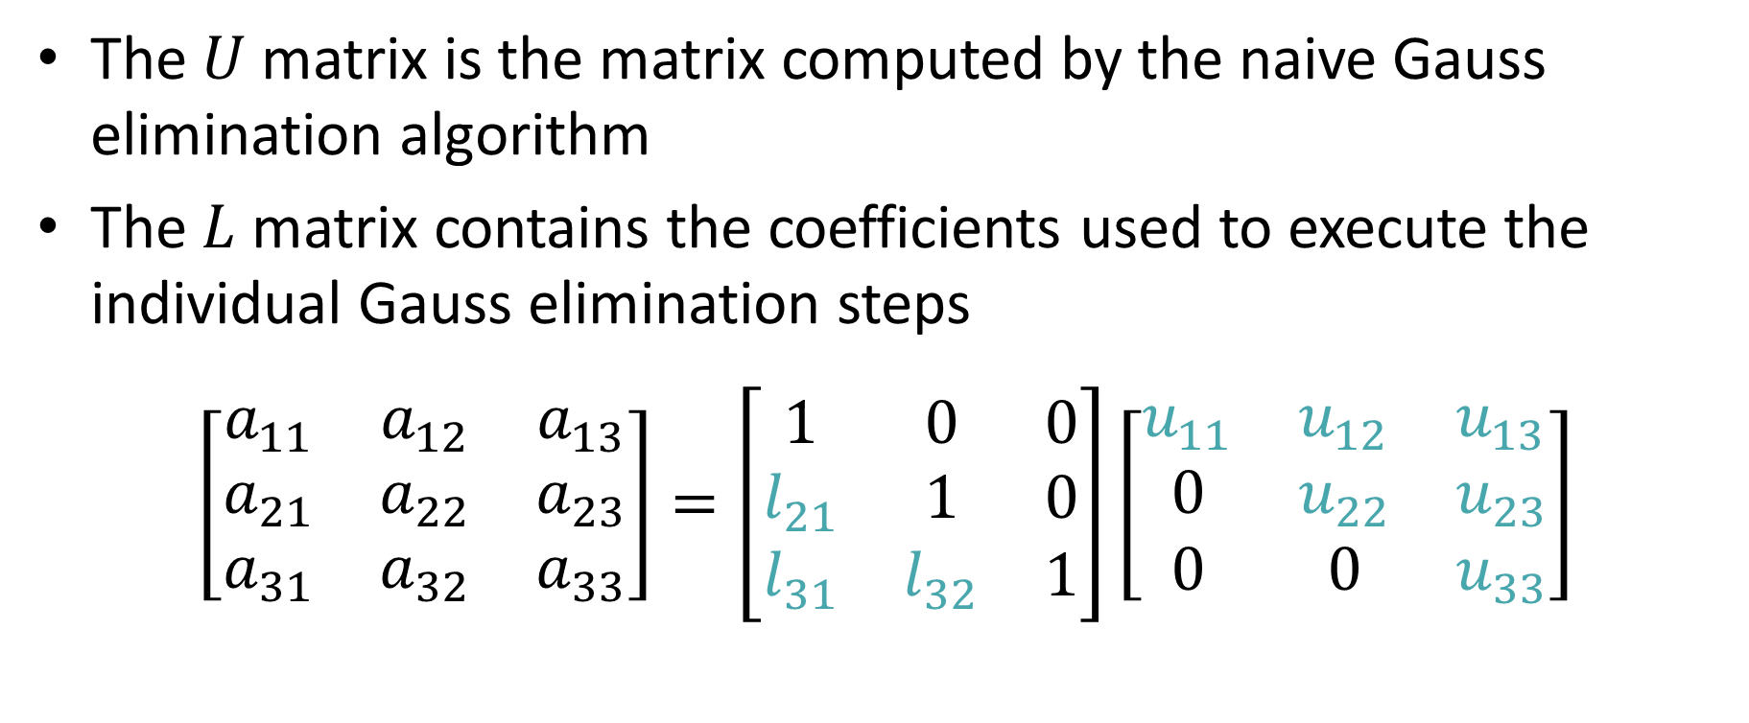



LU Decomposition
The $U$ matrix is the matrix computed by the naive Gauss elimination algorithm
The $L$ matrix contains the coefficients used to execute the individual Gauss elimination steps
$$\left[\begin{matrix}a_{11} & a_{12} & a_{13} \\ a_{21} & a_{22} & a_{23} \\ a_{31} & a_{32} & a_{33}\end{matrix}\right]=\left[\begin{matrix}1 & 0 & 0 \\ l_{21} & 1 & 0 \\ l_{31} & l_{32} & 1\end{matrix}\right]\left[\begin{matrix}u_{11} & u_{12} & u_{13} \\ 0 & u_{22} & u_{23} \\ 0 & 0 & u_{33}\end{matrix}\right]$$
Matrix $A$
Lower diagonal matrix $L$
Upper diagonal matrix $U$
Notes:
The LU decomposition of a matrix is built using two simple rules.
First, the $U$ matrix is the matrix computed by the naive Gauss elimination algorithm
Second, the $L$ matrix is obtained by filling the coefficients used to execute the individual Gauss elimination steps into the right places.
Recall that not all matrices A can be decomposed into such a product.
If the naive Gauss elimination step can not be performed on a system $A\underline{x}=\underline{b}$, then there is no LU decomposition of $A$

Slide 9
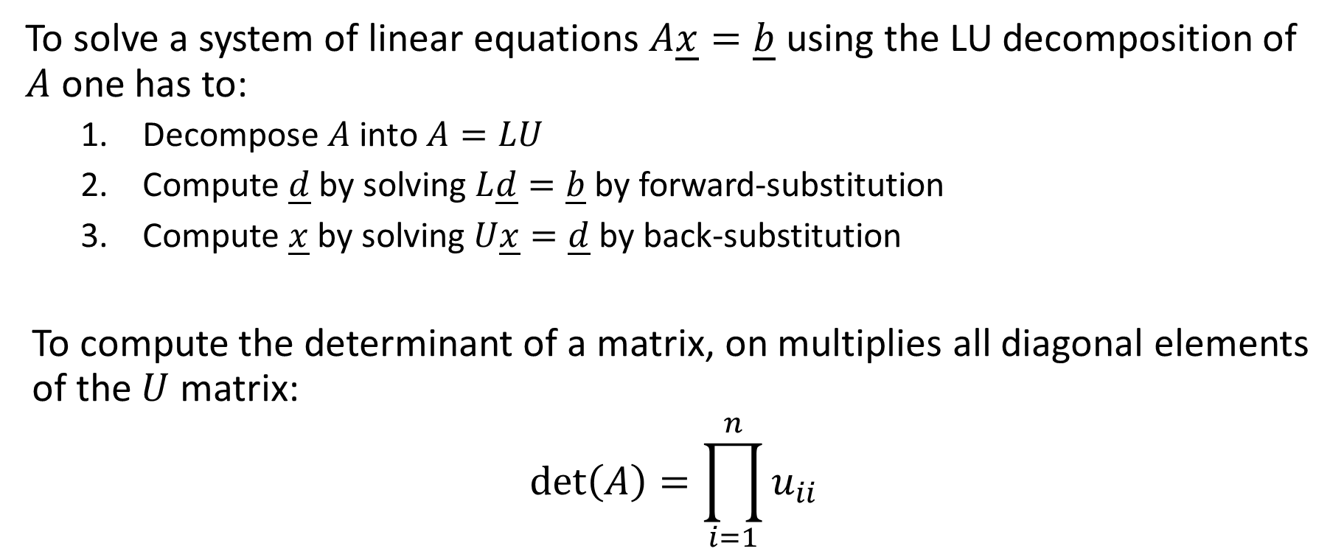
Applications of the LU decomposition
To solve a system of linear equations $A\underline{x}=\underline{b}$ using the LU decomposition of $A$ one has to:
Decompose $A$ into $A=LU$
Compute $\underline{d}$ by solving $L\underline{d}=\underline{b}$ by forward-substitution
Compute $\underline{x}$ by solving $U\underline{x}=\underline{d}$ by back-substitution
To compute the determinant of a matrix, on multiplies all diagonal elements of the $U$ matrix:
$$\text{det}\left(A\right)=\prod_{i=1}^{n}{u_{ii}}$$
Notes:
We discussed two applications of the LU decomposition
The first one was to solve linear systems and the second one to compute the determinant of a matrix.
To solve a system of linear equations $A\underline{x}=\underline{b}$ using the LU decomposition of $A$ one has to:
First decompose $A$ into $A=LU$
Second compute $\underline{d}$ by solving $L\underline{d}=\underline{b}$ by forward-substitution
And third compute $\underline{x}$ by solving $U\underline{x}=\underline{d}$ by back-substitution
To compute the determinant of a matrix, on multiplies all diagonal elements of the $U$ matrix.

Slide 10
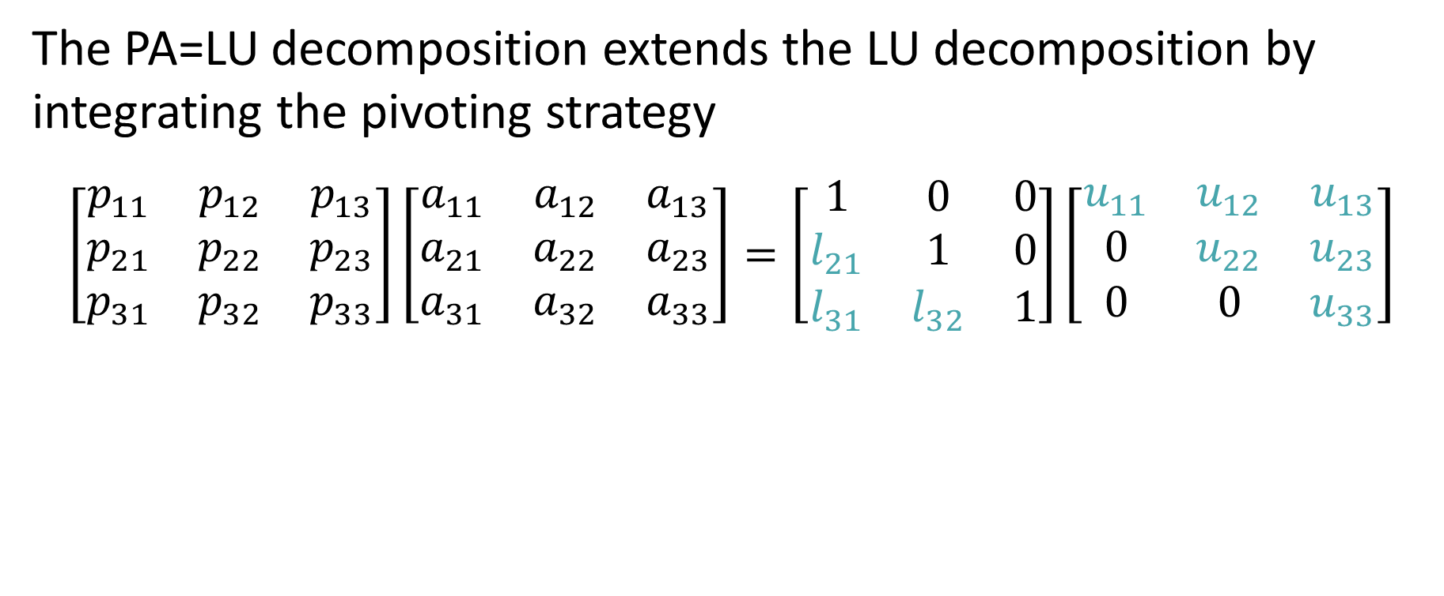




PA=LU Decomposition
The PA=LU decomposition extends the LU decomposition by integrating the pivoting strategy
$$\left[\begin{matrix}p_{11} & p_{12} & p_{13} \\ p_{21} & p_{22} & p_{23} \\ p_{31} & p_{32} & p_{33}\end{matrix}\right]\left[\begin{matrix}a_{11} & a_{12} & a_{13} \\ a_{21} & a_{22} & a_{23} \\ a_{31} & a_{32} & a_{33}\end{matrix}\right]=\left[\begin{matrix}1 & 0 & 0 \\ l_{21} & 1 & 0 \\ l_{31} & l_{32} & 1\end{matrix}\right]\left[\begin{matrix}u_{11} & u_{12} & u_{13} \\ 0 & u_{22} & u_{23} \\ 0 & 0 & u_{33}\end{matrix}\right]$$
Permutation matrix $P$
Matrix $A$
Lower diagonal matrix $L$
Upper diagonal matrix $U$
Notes:
The PA=LU decomposition extends the LU decomposition by integrating the pivoting strategy

Slide 11
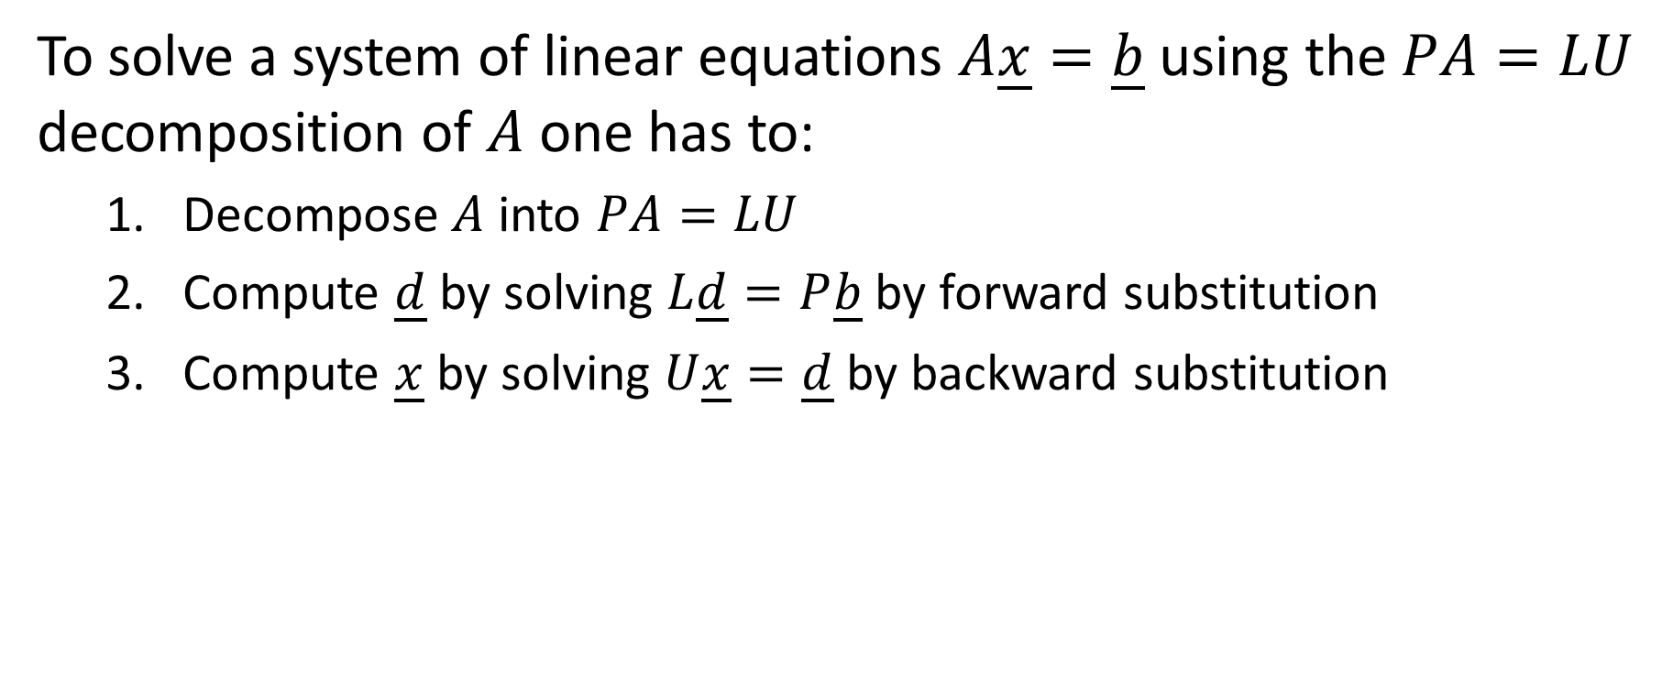
Solving systems with the PA=LU decomposition
To solve a system of linear equations $A\underline{x}=\underline{b}$ using the $PA=LU$ decomposition of $A$ one has to:
Decompose $A$ into $PA=LU$
Compute $\underline{d}$ by solving $L\underline{d}=P\underline{b}$ by forward substitution
Compute $\underline{x}$ by solving $U\underline{x}=\underline{d}$ by backward substitution
Notes:
To solve a system of linear equations $A\underline{x}=\underline{b}$ using the PA=LU decomposition of $A$ one has to:
First decompose $A$ into $PA=LU$
Second compute $\underline{d}$ by solving $L\underline{d}=P\underline{b}$ by forward-substitution
And third compute $\underline{x}$ by solving $U\underline{x}=\underline{d}$ by back-substitution

Slide 12
Quantifying errors for system of equations
For system of equations vector norms are used to measure errors
There exist various ways to define vector norms
A very popular norm in numerical methods is the infinity norm as it requires almost no calculations to determine it
Using vector norms forward and backward errors as well as the error magnification factor can be defined
Notes:
For system of equations vector norms are used to measure errors
There exist various ways to define vector norms
A very popular norm in numerical methods is the infinity norm as it requires almost no calculations to determine it
Using vector norms forward and backward errors as well as the error magnification factor can be defined

Slide 13
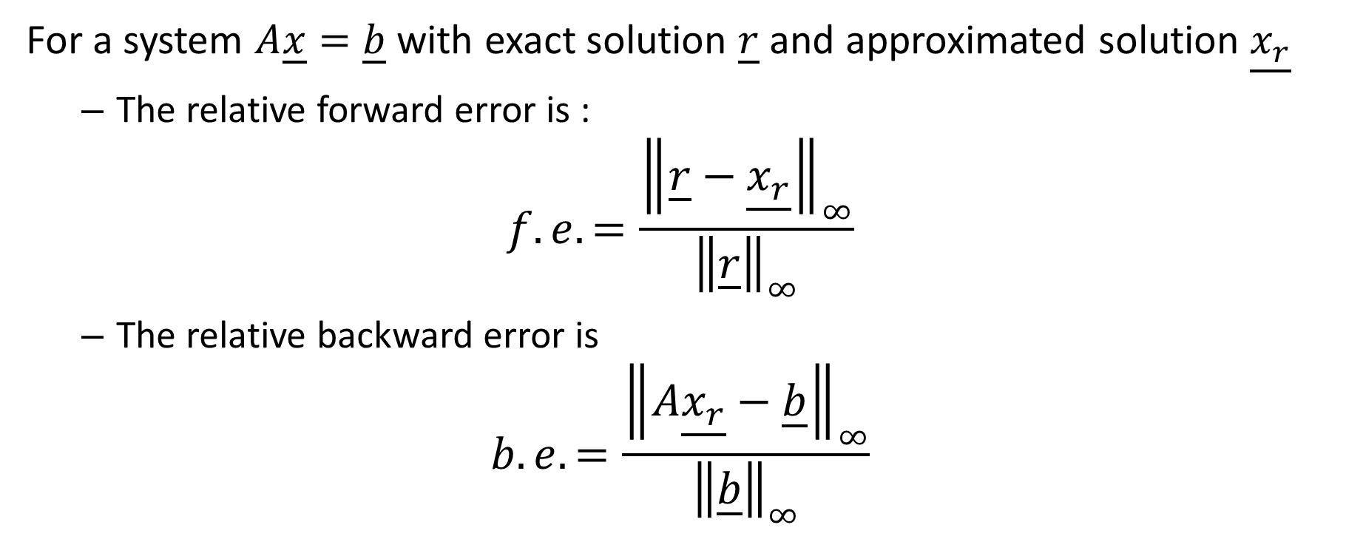
Forward and Backward Errors
For a system $A\underline{x}=\underline{b}$ with exact solution $\underline{r}$ and approximated solution $\underline{x_{r}}$
The relative forward error is :
$$f.e.=\frac{{\left\|\underline{r}−\underline{x_{r}}\right\|}_{∞}}{{\left\|\underline{r}\right\|}_{∞}}$$
The relative backward error is
$$b.e.=\frac{{\left\|A\underline{x_{r}}−\underline{b}\right\|}_{∞}}{{\left\|\underline{b}\right\|}_{∞}}$$
Notes:
For a system $A\underline{x}=\underline{b}$ with exact solution $\underline{r}$ and approximated solution $\underline{x_{r}}$
The relative forward error is the ratio between the absolute forward error and the infinity norm of the exact solution.
The relative backward error is the ratio between the absolute backward error and the infinity norm of the right hand-side vector b.

Slide 14

Error Magnification Factor
The error magnification factor $M$ is:
$$M=\frac{f.e.}{b.e.}=\frac{\frac{{\left\|\underline{r}−\underline{x_{r}}\right\|}_{∞}}{{\left\|\underline{r}\right\|}_{∞}}}{\frac{{\left\|A\underline{x_{r}}−\underline{b}\right\|}_{∞}}{{\left\|\underline{b}\right\|}_{∞}}}$$
Notes:
The error magnification factor is the ratio between forward and backward error.

Slide 15

Predicting the Error Magnification Factor
Theorem
The largest to be expected error magnification factor when solving a linear system of equations $A\underline{x}=\underline{b}$ is given by:
$$\text{cond}\left(A\right)={\left\|A\right\|}_{∞}∙{\left\|A^{−1}\right\|}_{∞}$$
Notes:
The largest to be expected error magnification factor when solving a linear system of equations $A\underline{x}=\underline{b}$ is given by the conditioning number of the coefficient matrix A.
The conditioning number of the coefficient matrix can be calculated by multiplying the infinity norm of the A with the infinity norm of the inverse of A

Slide 16

Matrix Norm
Definition
The infinity norm of a matrix $A$ is defined as:
$${\left\|A\right\|}_{∞}=\text{maximum} \text{absolute} \text{row} \text{sum}$$
Notes:
The infinity norm of a matrix $A$ is defined as the maximum absolute row sum

Slide 17
Application of the error magnification factor
The error magnification factor tells us how many significant digits we will loose in our calculations
If we have an error magnification factor of $M≅{10}^{d}$ then:
$$\frac{{\left\|\underline{∆r}\right\|}_{∞}}{{\left\|\underline{r}\right\|}_{∞}}=M×ε_{Mach}={10}^{d−16}$$
We started our calculations we 16 significant digits (input error) but end with only $16−d≅16−\log_{10}M$ digits (output error)
Notes:
The error magnification factor tells us how many significant digits we will loose in our calculations
For an error magnification factor of about 10 to the power d the smallest forward error we can hope to expect is 10 to the power d minus 16
We stared our calculation with 16 correct significant digits.
But due to the error magnification factor, we can never get an solution better than 16-d digits.

